Slide 1
An End-to-End Trainable Neural Network for Image-based Sequence Recognition
分享人：梅昊铭

Slide 2
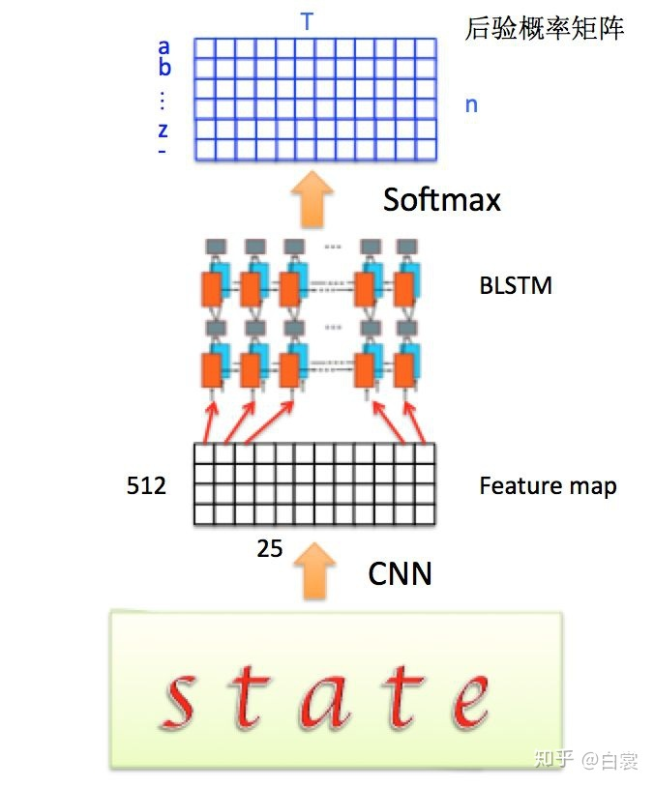
Overview
Introduction
Topic
Technical Background
Brief in Author's Work
CRNN Model
Feature Sequence Extraction
Sequence Labeling
Transcription
Experiments and Conclusion
Datasets and Implementation Details
Comparative Evaluation
Conclusion

Slide 3

Topic
Image-based Sequence Recognition
Occur in the form of sequence ,not in isolation
Predict a series of object labels instead of a single label
Length may vary drastically
Sence Text Recognition
Sequence-like objects
Detect individual characters and recognize them with DCNN
as an image classification problem

Slide 4
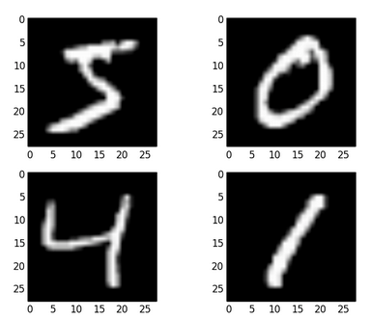
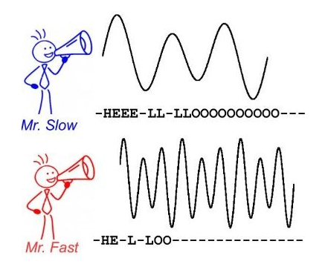
Technical Background
DCNN Models
Detect individual characters and recognize them or treat as an image
classification (VGG,GoogleNet,ResNet)
Operate on fixed demensions
Can't be applied to sequence prediction with a variable length
RNN Model
appropriate for handling sequence problems
Not need the position of each element
but need to extract the image sequence features

Slide 5
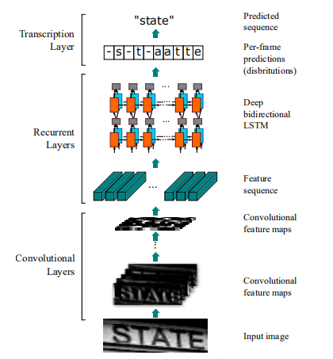
Brief in Author's Work
The main contribution of this paper is a novel nerual network model,whose network architecture is designed for recognizing sequence-like objects in images.
The network is named as Convolutional Recurrent Neural Network (CRNN),a combination of DCNN and RNN.
The architecture consists of three parts:
convolutional layers: extract feature sequences
recurrent layers : predict a label distribution for each frame
transcription layer: translate the per-frame predictions into
the final label sequence

Slide 6
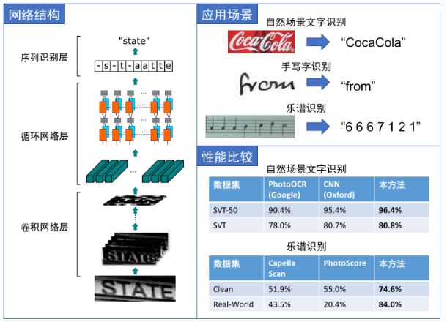
The Network Architecture
Transcription Layer
Recurrent Layers
Convolutional Layers

Slide 7
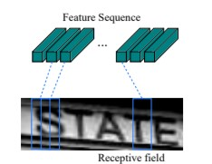
Feature Sequence Extraction
Consists of convolutional layers and max-pooling layers,which can extract the feature sequence of images
The feature sequence comes from the feature map,which is the input of recurrent layers
Each feature vector corresponds to the recpetive field of the original image.
Each vector can be considered as the descriptor for that region

Slide 8
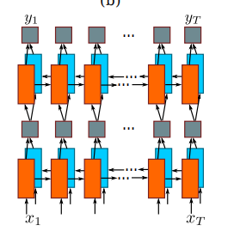
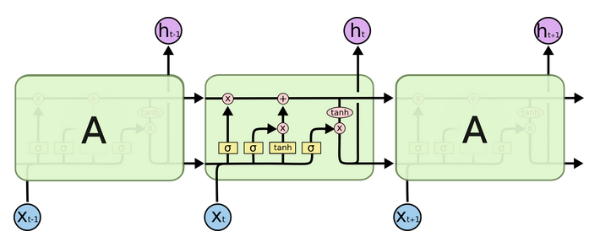
Sequence Labeling
The recurrent layers consist of two bidirectional LSTM layers.
LSTM Block:
Bi-LSTM:
Notes:
http://colah.github.io/posts/2015-08-Understanding-LSTMs/

Slide 9


Transcription
Transcription is the process of converting the per-frame predictions made by RNN into a label sequence.
Mathematically,ranscription is to find the label sequence with the highest probability.
Adopt the conditional probability defined in the Connectionist Temporal Classification (CTC) proposed by Graves.
Conditional Probability:
Find the sequence with highest probability:
Function B can maps “--hh-e-l-ll-oo--” onto “hello”

Slide 10

Network Training
Objective Function:
The network is trained with AdaDelta Algorithm,which can automatically calculate per-dimension learning rates and converges faster than the momentum method.

Slide 11
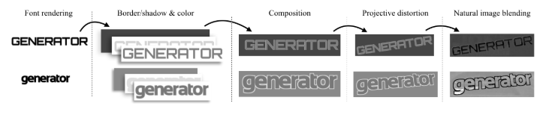
Experiments
Train on synthetic dataset released by Jaderberg,which contains 8 millions training images and their corresponding ground truth words.
Test on ICDAR 2003,ICDAR 2013,IIIT 5k-word and Street View Text.
Though trained with synthetic dataset,it works well on real images from standard text recognition benchmarks.

Slide 12
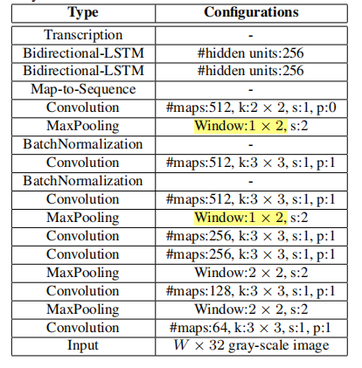
Implementation Details
The convolutional layers is based on VGG architectures.
Adopt the size of conv-kernel in the 3rd and 4th max-pooling layers
Add Batch Normalization after conv-layers
The recurrent layers consist of two Bidirectional-LSTM.
Transcription:CTC

Slide 13
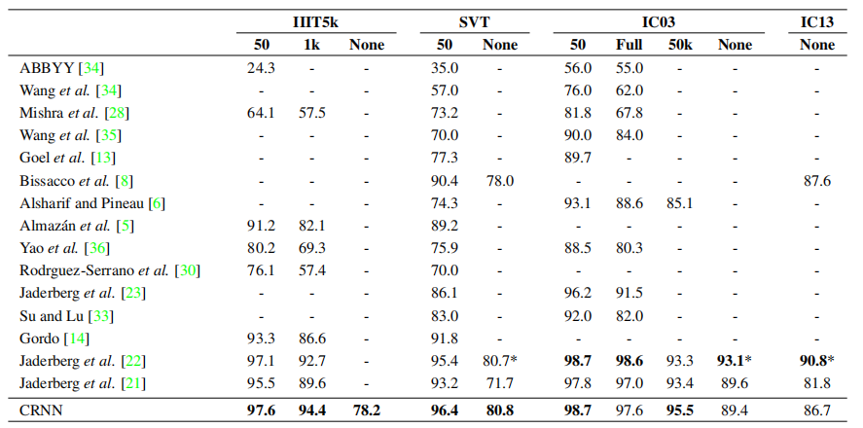
Comparative Evaluation

Slide 14
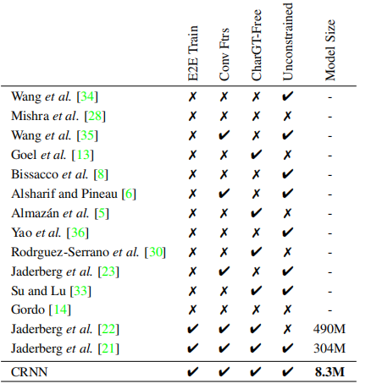
Attributes for comparison:
being end-to-end trainable
using convolutional features
ground truth bounding boxes for characters
not confined to a pre-defined dictionary
the model size

Slide 15
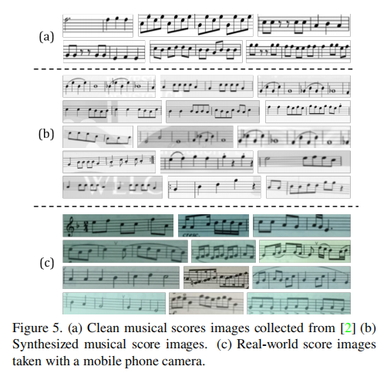
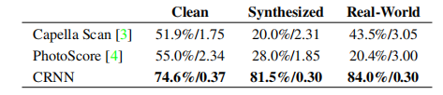
Musical Score Recognition
The results have shown the generality of CRNN,in that it can be readily applied to other image-based sequence recognition problems.

Slide 16
Conclusion
Present a novel neural network architecture,called CRNN
Be able to take input images of varying dimensions and predict sequence with different lengths
Not requiring detailed annotations,such as characters
Efficient and High Accuracy
Generality

Slide 17
Thank You for Watching!

